Slide 1

MY DIGITAL WORLD PROGRAMME
Digital Empowerment and Opportunities
Presenter:____________________
Date: XX/XX/2024

Slide 2
Digital Empowerment and Opportunities: Agenda
01 Advocacy and Making change
02 Building Your Advocacy Network
03 Raising Awareness Through Media
04 Hashtags
05 Time for Action
06 Exploring Experiences
07 Identifying Our Strengthens
08 What is an Algorithm?
09 Social Media Algorithm
Notes:
Speaker Notes:
The lessons and activities in this section help learners explore their identities, engage with others (both individuals and the larger collective) online in empathic, ethical, and positive ways, and counteract the risks the digital world may come with to protect their physical and mental health.

Slide 3

01 Advocacy and Making Change
What is
Advocacy?
Notes:
Speaker Notes:
LESSON OBJECTIVE
Students will learn about the concept of advocacy by identifying an issue that affects their community and brainstorming two changes that they want to see in the future concerning that problem.
ESTIMATED TIME
2 Days and 30 Minutes
ESSENTIAL QUESTIONS
What is a community?
How can you identify and address issues in your community that are important to you?
MATERIALS
Poster Paper
Projector
PREPARATION
Identify a website used for advocacy that your students will be familiar with.
There are several opportunities to localize content to your students’ experience and local context. These opportunities are flagged as “Teacher’s Notes” throughout. We suggest you read through the lesson ahead of time and prepare the examples before the lesson begins.
OPTIONAL: ISTE DIGCITCOMMIT COMPETENCY
ENGAGED: I use technology and digital channels for civic engagement, to solve problems, and to be a force for good in both physical and virtual communities.

Slide 4
01 Advocacy and Making Change
What is
Advocacy?
The desire to stick up for causes that you believe in and create change
Notes:
Speaker Notes:
Part 1
TELL YOUR STUDENTS
There are many aspects of our communities and surroundings that we appreciate. Maybe we are grateful for our friends. It could be that we enjoy getting to play on a particular sports team. Perhaps we love having the opportunity to listen to new music from artists we like.
However, sometimes there are aspects about our community that don’t sit well with us. Maybe the school just put a new dress code in place, requiring expensive clothes that we cannot afford. Perhaps an elected politician is trying to create laws that don’t consider our needs. It’s possible that the transportation options where we live are not designed to take us to the places that we need to go.

Slide 5
What if you had to take several buses and long walk to reach the nearest Gebeya?
01 Advocacy and Making Change
How might you try to change this?
Are there people you might reach out to who can help you?
Maybe you have friends with similar problems. How might you all stand up for yourselves?
Notes:
Speaker Notes:
TELL YOUR STUDENTS
Let’s say you noticed that you had to take several buses and a long walk to reach the nearest Gebeya.
ASK YOUR STUDENTS
How might you try to change that?
Are there individuals you might reach out to who can help you?
Maybe you have friends who experience some of the same problems as you. How might you all stand up for yourselves?

Slide 6


01 Advocacy and Making Change
Activity
Research and identify an aspect if your community that you would like to change.
What issues do you have in your community that are important to you?
Create a poster to illustrate the problem and/ or solutions.
Notes:
Speaker Notes:
TELL YOUR STUDENTS
Now we are going to identify one issue in your community that you’re passionate about and some next steps you and the community might take to solve a problem.
ASSIGNMENT
Split students into groups of three. Give each group time in the current session and at least two full days to 1) research a problem impacting their community, identifying at least two ways the issue is affecting their community and two ways to potentially solve the problem, and 2) develop a poster that provides information on the identified issue and potential solutions that they will present to the larger group as part of a “gallery walk.”
TELL YOUR STUDENTS
In your groups:
Research and identify an aspect of your community (a “community” could be your school, neighborhood, or a local group you belong to) that you would like to change. You can talk to your friends, teachers, and/or family about things they would like to change or about the problems affecting them.
Create a poster. The posters created by each group will be hung on the wall and we will do a “gallery walk” together where each group will discuss the problem they identified and how to solve it.
Each group must identify at least two ways the issue is affecting their community and two potential ways to solve it.
Be creative: Take photos and paste them onto the poster (ideally, make sure students have access to a printer) to illustrate the problem and/or the solutions or use flowcharts, graphs, and charts to communicate the extent of the problem and/or the solutions.
Each poster should “stand alone” — in other words, the poster should have enough information on it so that someone can view/read it and understand the issue and potential solutions without a group member’s explanation.
ASSIGNMENT
Give each group enough time to engage in research and develop their posters. Make sure that you are available for questions and technical support. When the larger group reconvenes, have students hang the posters on the wall, give the larger group 20 minutes to walk around and look at others’ posters, then allow about 30 minutes to have each smaller group present their poster to the larger group.

Slide 7

02 Building Your Advocacy Network
What is an advocacy network?
Advocacy networks focus on the mobilization, interpretation, and strategic dissemination of information to change behaviour.
Notes:
Speaker Notes:
LESSON OBJECTIVE
Students will learn about the concept of advocacy by identifying an issue that affects their community and brainstorming two changes that they want to see in the future concerning that problem.
ESTIMATED TIME
2 Days and 30 Minutes
ESSENTIAL QUESTIONS
What is a community?
How can you identify and address issues in your community that are important to you?
MATERIALS
Poster Paper
Projector
PREPARATION
Identify a website used for advocacy that your students will be familiar with.
There are several opportunities to localize content to your students’ experience and local context. These opportunities are flagged as “Teacher’s Notes” throughout. We suggest you read through the lesson ahead of time and prepare the examples before the lesson begins.
OPTIONAL: ISTE DIGCITCOMMIT COMPETENCY
ENGAGED: I use technology and digital channels for civic engagement, to solve problems, and to be a force for good in both physical and virtual communities.

Slide 8


02 Building Your Advocacy Network
“It isn’t what you know,
It is who you know.”
Notes:
Speaker Notes:
Using Human Social Networks for Advocacy
Part 1
TELL YOUR STUDENTS
There is a famous phrase that says, “It isn’t what you know. It is who you know.” While this isn’t 100% accurate (what you know is also incredibly important!), it is a helpful reminder of the importance of networks.
Whether you are looking for a job or trying to play sports at the next level, having a good network can allow you to make contacts who can help you achieve your goals. Advocacy efforts are no different. The bigger and better the network of people we know, the easier it will be to create change in our communities.
From our family members and friends to our teachers and community leaders, we already know more people than we think, especially when we include friends of friends and extend our network beyond those closest to us. These individuals can be great resources for reaching our goals.
There are many people we might not know yet who can help us achieve our goals. Social media and the internet more broadly present other ways of meeting the kinds of individuals who might contribute skills or resources to our advocacy efforts.

Slide 9
02 Building Your Advocacy Network
Activity
What is the main message of the campaign?
What causes do you care about?
What platform is the most effective?
Who is the intended audience? Did your campaign reach its intended audience?
Notes:
Speaker Notes:
Part 2
TEACHER’S NOTE
On a projection screen at the front of the room, show a video example aligned with your/students’ local/regional context to showcase how people are connected through social networks and how we can benefit from these connections.
ASK YOUR STUDENTS
How might information be spread effectively through your existing social networks? How can we use these connections to promote advocacy efforts?
TELL YOUR STUDENTS
In the following activity, you will create a shareable online resource that describes the cause that you care about.
By sharing your advocacy efforts online, you can tell others about what you care about and potentially meet new people who may be able to assist your efforts!
ASSIGNMENT
TELL YOUR STUDENTS
Create a shareable online resource (e.g., using Canva, Google Docs, a social media platform like Twitter, Facebook, or Instagram), a WordPress blog, a website on Neocities, a slide presentation using Scratch, Microsoft PowerPoint, or Google Slides) about an issue you care about, where you will: Write an introduction explaining the cause and why you believe it’s important.
Provide links for several websites (e.g., an online article) dedicated to the issue.
List three people who write, blog, tweet, or make digital media content about this area. (Optional: If you can, write a tweet to each of these individuals and tell them about your cause and what you would like to achieve.)
CLASS INTERACTION
Give students 30 minutes to complete the activity. Depending on the time allotted, in the current or the second group convening, ask students to share their resources with the larger group and have a 15-minute discussion highlighting effective strategies.
TEACHER’S NOTE
When discussing effective strategies with your class, make sure they are considering the following:
What is the main message of the advocacy/campaign?
What platform is the most effective in the campaign?
Who is the intended audience? Did the campaign reach its intended audience?

Slide 10

03 Raising Awareness Through Media
Social media gives its users the power to build communities around a cause and encourage supporters to take action. This is done by sharing images, stories, and videos to raise awareness and facilitate discussion.
Notes:
Speaker Notes:
LESSON OBJECTIVE
Students will learn about and identify ways in which various types of media can be used to promote awareness around an issue.
ESTIMATED TIME
1 Hour and 5 Minutes
ESSENTIAL QUESTION
How can digital media promote awareness around an issue?
MATERIALS
Projector
PREPARATION
Identify a video to demonstrate how media can be used to foster awareness and advocacy relevant to your community.
Students need internet access to complete this lesson.
There are several opportunities to localize content to your students’ experience and local context. These opportunities are flagged as “Teacher’s Notes” throughout. We suggest you read through the lesson ahead of time and prepare the examples before the lesson begins.
OPTIONAL: ISTE DIGCITCOMMIT COMPETENCY
ENGAGED: I use technology and digital channels for civic engagement, to solve problems, and to be a force for good in both physical and virtual communities.

Slide 11
03 Raising Awareness Through Media
Marcus cooks shares recipes and healthy eating on Instagram
Dawit Dreams shares motivational content on YouTube and Instagram
Using Media for Change
Comedian Eshetu shares funny content on YouTube for children
MERI Podcast shares content on the entrepreneurship landscape in Ethiopia
Notes:
Speaker Notes:
ESTIMATED TIME
2 Minutes
Using Media for Change
TELL YOUR PARTICIPANTS
Media is an awesome tool for sharing ideas with others. For many, digital media platforms are their favorite way to communicate their messages.
TRAINER’S NOTE
Share examples of local digital influencers who are spreading their message on digital platforms. This example is intended to show students how others use the internet to advocate for a cause they care about. Examples could include:
Ethiopia: Marcus cooks, Dawit Dreams, Comedian Eshetu

Slide 12

03 Raising Awareness Through Media
As advocates for change, media of all sorts can be a powerful tools for achieving our goals.
Notes:
Speaker Notes:
TEACHER’S NOTE
On a projection screen at the front of the room, show a recent video example aligned with your/students’ local/regional context to illustrate further how media can be used to foster awareness and advocacy around a particular cause.
TELL YOUR STUDENTS
When engaging in advocacy efforts, media of all sorts can be powerful tools for achieving our goals. In the following activity, you will explore this idea by creating a message and spreading it across various types of media to reach a large audience.

Slide 13



03 Raising Awareness Through Media
Activity
An Image
Create your own media content to raise awareness around your cause
A Text Post
A video Idea
Notes:
Speaker Notes:
TELL YOUR STUDENTS
Now that we’ve found and discussed an inspiring and effective example of media to promote a cause, it’s time for you to create your own media content around a cause you care about.
Over the next 20 minutes, think of a cause that is important to you and write down your idea for a specific type of media to raise awareness around the cause. This might include:
A text post to communicate your cause and why people should take action
An idea for an image or graphic (or image/graphic itself) to communicate the cause and how others can help support it
An idea for a video to raise awareness and encourage action around the cause
In addition to this idea, please also write down:
At least two possible ways you might spread your media message to increase visibility and awareness of the cause
CLASS INTERACTION
Give students 20 minutes to write down their ideas. Afterward, ask students to share what they wrote with the larger group. Take 15 minutes for discussion.

Slide 14


04 Hashtags
Hashtag is a word or keyword phrase preceded by a hash symbol (#). It's used within a post on social media to help those who may be interested in your topic to be able to find it when they search for a keyword or particular hashtag.
Notes:
Speaker Notes:
LESSON OBJECTIVE
Students will learn how hashtags have been effective in promoting social movements. Students will also identify how hashtags on social media can help raise awareness about an advocacy issue and will develop their own hashtag and methods of promotion for a cause that interests them.
ESTIMATED TIME
1 Hour and 10 Minutes
ESSENTIAL QUESTIONS
How have others made use of hashtags to promote a cause?
How can you use hashtags to raise awareness around an issue?
PREPARATION
Identify a video to demonstrate how media can be used to foster awareness and advocacy relevant to your community.
Students need internet access to complete this lesson.
There are several opportunities to localize content to your students’ experience and local context. These opportunities are flagged as “Teacher’s Notes” throughout. We suggest you read through the lesson ahead of time and prepare the examples before the lesson begins.
OPTIONAL: ISTE DIGCITCOMMIT COMPETENCY
ENGAGED: I use technology and digital channels for civic engagement, to solve problems, and to be a force for good in both physical and virtual communities.

Slide 15
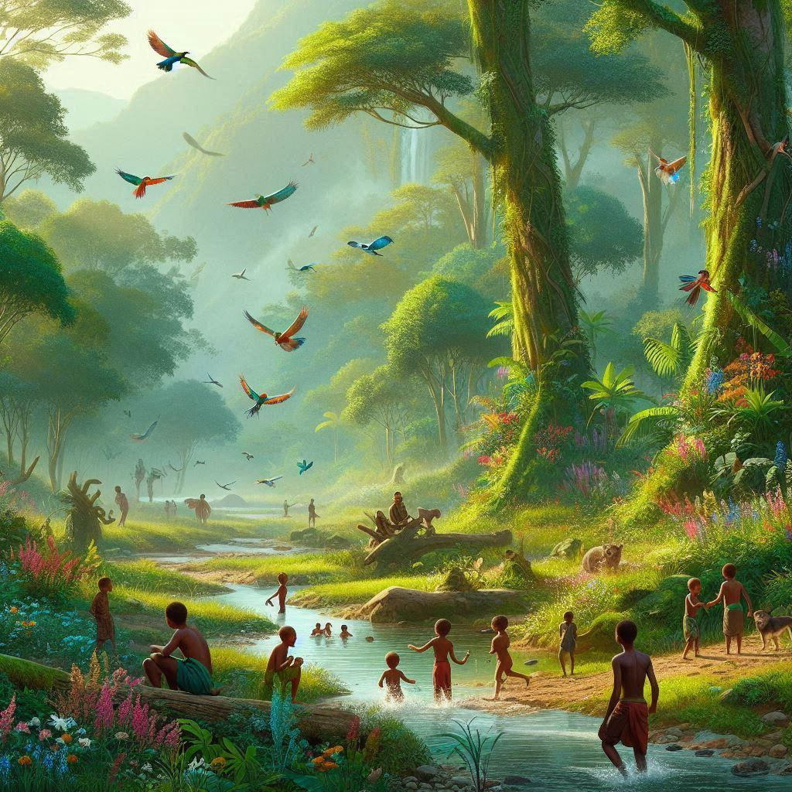


Advocacy Using Hashtags
04 Hashtags
#GreenEthiopia
#ItsmyDam
#DigitalEthiopia2025
Notes:
Speaker Notes:
Advocacy Using Hashtags
TELL YOUR STUDENTS
While individuals often use specific social media platforms in advocacy campaigns for particular reasons, these platforms share certain characteristics. One helpful common feature is the hashtag. Hashtags allow us to draw attention to our ideas by connecting our posts to other posts on the same topic. For instance, if we wanted to share videos from our recent football game where our striker performed a hat trick, we could include “#football and “#hattrick” in the description of the video to allow other people looking for football videos to see it. This way, we could increase the chances that professional sports scouts might view our videos.
TEACHER’S NOTE
Share additional examples of local hashtags that are used to spread important messages on digital platforms. The goal of this example is to educate students on hashtags and how they can be used to advocate for a cause
TELL YOUR STUDENTS
When you are advocating for a cause, using hashtags is a great way to reach an audience with your ideas. In the following exercise, we will explore the use of hashtags on social media.

Slide 16


04 Hashtags
Activity
 | Create a Hashtag
 | Design an image, infographic, meme, chart, or graph
 | Strategies how you can spread your Hashtag
Create your own Hashtag!
Select an issue that is important to you & create a hashtag for it.
Notes:
Speaker Notes:
Part 2
TELL YOUR STUDENTS
Now, come up with an issue that is important to your pair and:
Create a hashtag for it.
Design an image, infographic, meme, chart, or graph to promote your hashtag.
With your partner, discuss various ways that you can spread your hashtag through a network. What are some successful strategies we learned from examining other hashtags?
You will have 30 minutes to complete this exercise.
CLASS INTERACTION
Give students 30 minutes to engage in this exercise with their partner. Afterward, allow 20 minutes for pairs to discuss, with the larger group, their hashtag, accompanying visual and ideas for spreading the hashtag.

Slide 17


05 Time for Action
Community Building: Social media empowers users to create and nurture communities around shared causes by sharing impactful images, stories, and videos. This fosters awareness, discussion, and collective action.
Emerging Technologies:
Metaverse: A virtual space that can revolutionize how communities interact and collaborate online, offering immersive experiences for deeper engagement.
Artificial Intelligence (AI): Enhances social media platforms by personalizing content, improving user experience, and enabling advanced community management tools.
Neurology: Insights from neuroscience are being used to understand user behavior, optimize content delivery, and create more engaging social media experiences.
Notes:
Speaker Notes:
LESSON OBJECTIVE
Students will learn how to develop an initial plan for their own advocacy campaign.
ESTIMATED TIME
1 Hour and 25 Minutes
ESSENTIAL QUESTIONS
Why does taking action around issues matter?
How can digital technologies be used to help drive change?
MATERIALS
"Advocacy Campaign” Worksheet
PREPARATION
Print out a handout for every student.
Identify a video to demonstrate how media can be used to foster awareness and advocacy relevant to your community.
Students need internet access to complete this lesson.
There are several opportunities to localize content to your students’ experience and local context. These opportunities are flagged as “Teacher’s Notes” throughout. We suggest you read through the lesson ahead of time and prepare the examples before the lesson begins.
OPTIONAL: ISTE DIGCITCOMMIT COMPETENCY
ENGAGED: I use technology and digital channels for civic engagement, to solve problems, and to be a force for good in both physical and virtual communities.

Slide 18

05 Time for Action
Activity
Design your own community advocacy campaign
Notes:
Speaker Notes:
ASSIGNMENT
TELL YOUR STUDENTS
Create a write-up outlining an advocacy campaign you would like to run in your community. You can include the text you wrote in some of the previous learning experiences. For example, you might incorporate information about the issue that you want to address or an explanation about why a pop culture character you have chosen for your campaign aligns with your advocacy goals. Work together in small groups to brainstorm and develop your campaign plan. You will have 45 minutes to design your campaign.

Slide 19
05 Time for Action
What is the issue you want to address?
How do you want to address this issue?
Activity
Activity
Design your own community advocacy campaign
What community does this affect?
What media platforms will you use to raise awareness around your cause? In what ways?
Is there a celebrity or an influencer you would like to use for your campaign? How so?
What hashtag would you create for your campaign?
Who will be in your support network?
What is the timeline for your campaign?
Notes:
Speaker Notes:
TELL YOUR STUDENTS
Please answer the following questions:
What is the issue you want to address?
What community does this affect?
How do you want to address this issue?
What media platforms will you use to raise awareness around your cause? In what ways?
Is there a celebrity or an influencer you would like to use for your campaign? How so?
Who will be in your support network?
What hashtag would you create for your campaign?
What is the timeline for your campaign?
Ask your students to write their answers on a separate piece of paper.

Slide 20
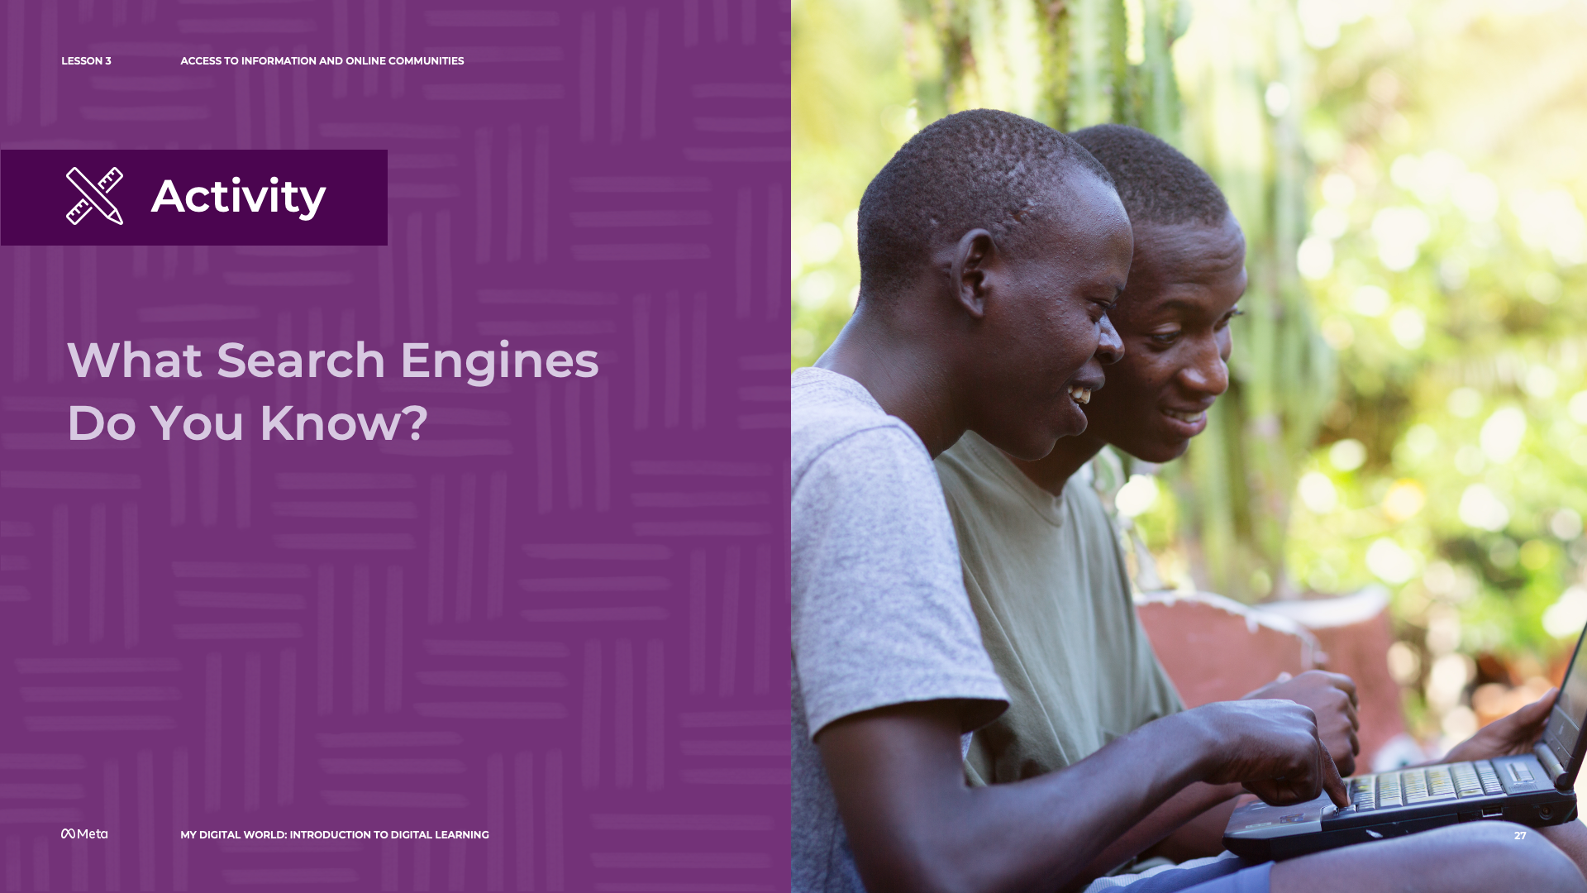
05 Time for Action
Activity
My advocacy campaign sharing session
Notes:
CLASS INTERACTION
Now, in pairs, you will share your advocacy campaign write-up. Talk with your partner about the aspect of your campaign that you are the most excited about!
Allow students 20 minutes to share their campaign.

Slide 21

06 Exploring Experiences
How do our experiences make us unique?
Notes:
Speaker Notes:
LESSON OBJECTIVE
Participants will learn to identify specific experiences that have shaped who they are today, reflect on how such experiences might be powerful for their future, and consider ways they can create new experiences that help them achieve their goals.
ESTIMATED TIME
1 Hour
ESSENTIAL QUESTION
How have your experiences shaped who you are today, and how can you create new meaningful experiences?
MATERIALS
“Taking on a New Challenge” Handout
“My Goal Plan” Handout
Computer with Internet Access
Projector and Projection Screen
Flip Chart or Poster (if a board is not available)
Marker
Paper
Pens or Pencils
PREPARATION
Print one handout per student.
Students will need internet access for this lesson.
There are several opportunities to localize content to your students’ experience and local context. These opportunities are flagged as “Teacher’s Notes” throughout. We suggest you read through the lesson ahead of time and prepare the examples before the lesson begins.
OPTIONAL: ISTE DIGCITCOMMIT COMPETENCY
BALANCED: I make informed decisions about how to prioritize my time and activities online and off.

Slide 22

Choose One of Your Most Memorable Experiences and Discuss
06 Exploring Experiences
Why is it memorable?
How has the memory shaped who you
are today?
Has this memory defined parts of your personality? How?
Notes:
Speaker Notes:
TELL YOUR STUDENTS
Now, I’d like you to choose at least one of your most memorable experiences and discuss it in pairs. Why is it memorable? How has the memory shaped who you are today? Think of the “Islands of Personality” in the video. Has this memory helped to create one (or more) of your islands (i.e., define parts of your personality)? If so, how? You’ll have 10 minutes to discuss with your partner.
CLASS INTERACTION
Organize participants into pairs. Give participants 10 minutes to discuss these questions.
ASK YOUR STUDENTS
Does anyone want to share one of their most memorable experiences?
After reflecting on how these experiences have helped define your personality, has anyone learned anything new or surprising about themselves?
Creating New Experiences
TELL YOUR STUDENTS
We all have different memories that give us a unique way of viewing and interacting with the world.
Some of these memories particularly stand out to us — core memories — and help define who we are.
If you’ve already completed Part 1: How Experiences Make Us Unique, feel free to disregard the following examples.
For example, let’s say you really love reading and writing poetry — your love for poetry is part of what makes you, you! Maybe one of your core memories is of a family remember reading poems to you when you were younger. Or maybe you’re passionate about travel and exploring new parts of the world. Perhaps one of your core memories is an amazing trip you took outside of the country when you were younger.
While our past experiences impact our identity, we can always create new memorable, and exciting experiences — experiencing new adventures and making new connections to people and places.
Often, depending on the choices we make, we have the possibility to create new experiences for ourselves.
Some of these choices can seem insignificant. But even making small changes in our day-to-day decisions can have a lasting impact.
Say, for instance, you really want to learn the guitar, but are worried you don’t have the time, given schoolwork and other activities outside of school. During the week, you only have about an hour of free time each day and you spend this time relaxing by watching TV. It is super important to do things that relax us, but what if you took just 15 minutes out of that hour to practice the guitar each day or every other day? Over time, this would help you get better and better and build your confidence in playing the guitar!
TEACHER’S NOTE
The examples above can be localized based on the experiences of your students and their local context. The examples above are intended to show how past experiences impact our identity, but new experiences can also shape who we are.

Slide 23

06 Exploring Experiences
Activity
Taking on a new challenge
Notes:
Speaker Notes:
TELL YOUR STUDENTS
Today, you’re going to each choose one medium-sized goal (i.e., a goal that you feel would take you at least several weeks to accomplish) that you’ve always wanted to achieve but have felt was too challenging and think about how you might accomplish this. This can be anything from becoming more mindful to exercising regularly, to learning about an area you’ve always been curious about (such as photography or a certain period from history).
Let’s begin by taking the next 15 minutes to fill out some questions that will help you start thinking of the goal you want to achieve and strategies you can use to reach it.

Slide 24
06 Exploring Experiences
Activity
Share a time when you faced a challenging goal in the past
How did you achieve it?
How did your past experiences shape how you approached the challenge?
Notes:
Speaker Notes:
Ask your students: To share a time when they faced a challenging goal and how they achieved it. How did your past experiences shape how you approached the challenge?
Tell your students to write their answers on a piece of paper

Slide 25
06 Exploring Experiences
Activity
My Goal Plan
Share some steps you are going to take to try and achieve your goal
Have past experiences shaped the steps you intend to take? How?
Notes:
Speaker Notes:
Ask your students: To share a time when they faced a challenging goal and how they achieved it. How did your past experiences shape how you approached the challenge?
Tell your students to write their answers on a piece of paper

Slide 26
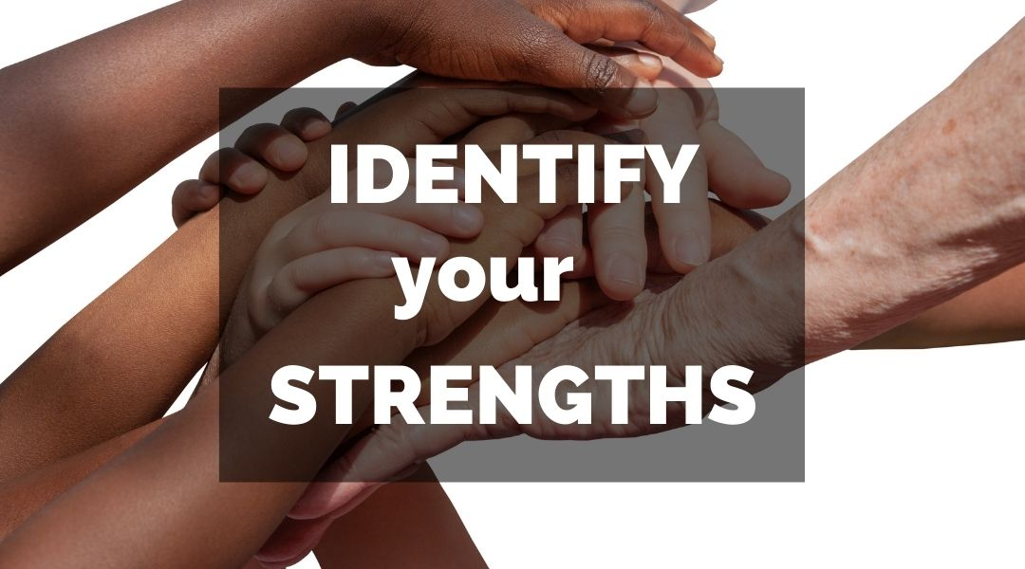
07 Identifying Our Strengths
What can you uniquely offer?
Notes:
Speaker Notes:
LESSON OBJECTIVE
Participants will identify three types of skills that they possess — transferable, knowledge/domain, and personal trait skills — and consider how they may combine these skills and apply them toward opportunities in the future.
ESTIMATED TIME
30 Minutes
ESSENTIAL QUESTION
How can you combine your skills in creative ways to pursue opportunities you’re excited about?
MATERIALS
“Assessing Your (Verb, Noun, and Adjective) Skills!” Handout
Paper
Pens or Pencils
PREPARATION
Print one handout per student.
Students will need internet access for this lesson.
There are several opportunities to localize content to your students’ experience and local context. These opportunities are flagged as “Teacher’s Notes” throughout. We suggest you read through the lesson ahead of time and prepare the examples before the lesson begins.
ISTE DIGCITCOMMIT COMPETENCY
BALANCED: I make informed decisions about how to prioritize my time and activities online and off.

Slide 27
07 Identifying Our Strengths
Activity
Assessing Your (Verb, Noun, and Adjective) Skills!
Transferable Skills
Skills you transfer from one opportunity to the next.
Knowledge or Domain Skills
Skills specific to a certain knowledge area.
Notes:
Speaker Notes:
TELL YOUR STUDENTS
two different types of skills: 1) transferable skills and 2) knowledge or domain skills. You can think of transferable skills as those skills that you could easily transfer from one opportunity to the next. For example, adapting to new situations and collaborating with others can help you thrive no matter where you are — in school or whatever career you ultimately choose, from being a nurse to a school teacher or a computer programmer. You can also think of these skills as verbs — like “researching,” “planning,” or “negotiating.” Knowledge or domain skills are those skills that are specific to a certain knowledge area, such as science (e.g., chemistry). Some examples of these skills could be knowing how to create a web page, creating fun infographics for papers, or conducting a chemistry experiment in a lab. You may have learned these skills in school, in an afterschool program, from books, from a mentor, or simply on your own. You can think of these skills as nouns, like “biology,” “Math,” or “economics.”
There are also skills that we feel describe how we go about doing things in our day-to-day life. These skills are called our personal trait skills and can be thought of as adjectives. For example, you may be very creative in how you approach an issue and enjoy thinking outside the box. Or you might be very caring toward others and always try hard to make situations as inclusive and equitable as possible. Or you may be strong-minded, which can help you persevere even as you hit obstacles.
Write down skills a person might have and rate those skills 1 – 5 (5- skills you are good at, 1- skill you need to work on)

Slide 28
07 Identifying Our Strengths
Activity
Write down 10 skills you rated most highly. Select a mix of:
Transferable Skills
Knowledge or Domain Skills
Personal Trait Skills
Notes:
Speaker Notes:
TELL YOUR STUDENTS
two different types of skills: 1) transferable skills and 2) knowledge or domain skills. You can think of transferable skills as those skills that you could easily transfer from one opportunity to the next. For example, adapting to new situations and collaborating with others can help you thrive no matter where you are — in school or whatever career you ultimately choose, from being a nurse to a school teacher or a computer programmer. You can also think of these skills as verbs — like “researching,” “planning,” or “negotiating.” Knowledge or domain skills are those skills that are specific to a certain knowledge area, such as science (e.g., chemistry). Some examples of these skills could be knowing how to create a web page, creating fun infographics for papers, or conducting a chemistry experiment in a lab. You may have learned these skills in school, in an afterschool program, from books, from a mentor, or simply on your own. You can think of these skills as nouns, like “biology,” “Math,” or “economics.”
There are also skills that we feel describe how we go about doing things in our day-to-day life. These skills are called our personal trait skills and can be thought of as adjectives. For example, you may be very creative in how you approach an issue and enjoy thinking outside the box. Or you might be very caring toward others and always try hard to make situations as inclusive and equitable as possible. Or you may be strong-minded, which can help you persevere even as you hit obstacles.
Write down skills a person might have and rate those skills 1 – 5 (5- skills you are good at, 1- skill you need to work on)

Slide 29
07 Identifying Our Strengths
Activity
Give a specific example of a time you used each skill.
From your list of 10 skills, how can you combine some of these skills to succeed?
Notes:
write down the 10 skills that you rated most highly. Try to pick a mixture of transferable skills and knowledge/domain skills (and add in a few personal trait skills you wrote down) — that is, verb, noun, and adjective skills. For each of the 10 skills, provide a SPECIFIC example of a time when you used this ability. Finally, from your list, choose at least five and think about how you could combine these skills to pursue and succeed in opportunities you’re excited about. Explain how you would combine these skills in a paragraph below your list.
For example, let’s say I’m a student who wants to be a doctor one day. I’m doing really well in my biology and chemistry classes (i.e., knowledge/domain skills) and I’m also really well at communicating with others and problem solving (i.e., transferable skills). Additionally, I feel that I approach new projects in a very patient and professional manner (i.e., a personal trait skill). I could use these skills in the future, after I get my medical license, to treat patients, help cure them from their ailments, and also greatly improve their quality of life with hopes that I can become a specialist doctor in the future.
TEACHER’S NOTE
The examples above can be localized based on the experiences of your students and their local context. The examples above are intended to teach students the difference between transferable skills and knowledge/domain skills.

Slide 30


What is an Algorithm?
08 What is an Algorithm?
Notes:
Speaker Notes:
LESSON OBJECTIVE
Participants will understand what an algorithm is, why algorithms matter, and how algorithms are used in both everyday life and computer science.
ESTIMATED TIME
2 Hours
ESSENTIAL QUESTIONS
What algorithms do you think shape your life?
Are there algorithms that impact you more than others, and if so, why?
MATERIALS
“What is an Algorithm?” Handout
“Recipe” Handout (Educator’s Copy and Participant Copy)
“Algorithms in Prime Time” Handout (Educator’s Copy and Participant Copy)
Projector and Projection Screen
Flip Chart or Poster (if a board is not available)
Marker
A set of eight large, white paper cups with the following numbers drawn in black marker on them (one number per cup): 5, 23, 28, 37, 64, 98, 110, and 125. (The numbers should be drawn a) on both sides of the cup, so that the educator can see one side and the participants can see the other and b) so that participants in the room will be able to see the numbers.)
A Table (so you can lay the eight cups out)
Paper
Pens or Pencils
Printout of “Muhammad ibn Mūsā al-Khwārizmī Statue Image”
Printout of all “7 Bubble Sort Images”
Printout of “Merge Sort Diagrams — Step One: Divide and Step Two: Conquer”
PREPARATION
Print handouts, images, and diagrams.
Purchase cups and number them as outlined.
Students will need internet access for this lesson.
There are several opportunities to localize content to your students’ experience and local context. These opportunities are flagged as “Teacher’s Notes” throughout. We suggest you read through the lesson ahead of time and prepare the examples before the lesson begins.
OPTIONAL: ISTE DIGCITCOMMIT COMPETENCY
INFORMED: I evaluate the accuracy, perspective, and validity of digital media and social posts.

Slide 31
What is an Algorithm?
08 What is an Algorithm?
An algorithm is a clearly given set of step-by-step instructions to solve a problem or accomplish a task.
Notes:
Speaker Notes:
Algorithm Fundamentals
TELL YOUR STUDENTS
Have you ever wondered how your favorite restaurant makes your favorite dish perfectly every time? Or how Siri or Alexa can respond to a question you’re asking? How self-driving cars work? Believe it or not, all these have one thing at their core: algorithms.
An algorithm is a clearly given set of step-by-step instructions to solve a problem or accomplish a task.
CLASS INTERACTION
Project this definition, the first bullet point on the “What Is an Algorithm?” handout, on a projection screen. Pass out the “What Is an Algorithm?” handout.
TELL YOUR STUDENTS
Algorithms might be expressed in words, computer programs or code, or even as recipes. Some algorithms may be simple routines, directions, or processes you use in your daily life.
For example, to wake yourself up in the morning, you might get out of bed, go to the bathroom and turn the water faucet to cold, let it run for 30 seconds, splash your face with water three times and pat your face dry with a towel.
Note here that these are steps to accomplish a task and they are very clear and detailed. For instance, the amount of time the faucet is turned on and the number of times you splash your face with water are noted.
Another example of an algorithm is a recipe for your favorite cookies where the instructions are clearly given, step by step.
But not all routines/recipes are algorithms. We’ll get to this point soon!
ASK YOUR STUDENTS
You can probably think of many types of routines you do every day that accomplish different tasks. Can anyone share an example of steps to one of your routines?
Possible examples could include, for instance, the directions needed in getting from their house to their friend’s house, the sequence of warm-up exercises they follow before taking a run, or the set of steps involved in washing their clothes. As participants share their routines, ask participants if they feel their steps are clear/precise.
TELL YOUR STUDENTS
You have actually worked with algorithms in every math class you’ve taken. In school, you learned algorithms for addition, subtraction, multiplication, and division. In geometry, you calculate areas of geometric shapes using algorithms. For example, when you calculate the area of a rectangle, you use a simple algorithm that multiplies the length of the rectangle by the width of the rectangle.
ASK YOUR STUDENTS
Can you think of other instances from math where you used an algorithm to solve a mathematical problem? Possible examples include adding and multiplying fractions (e.g., 3 4 + 18 = 68 + 18 = 78) and/or solving equations (e.g., 3x + 2 = 5).

Slide 32
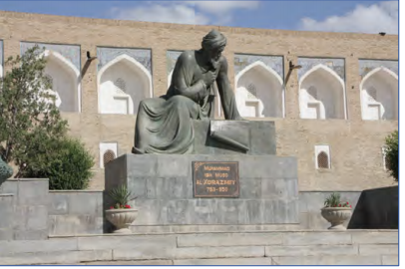
08 What is an Algorithm?
Statue of Muhammad ibn Mūsā al-Khwārizmī Khiva, Uzbekistan
Notes:
Speaker Notes:
TELL YOUR STUDENTS
The concept of an algorithm has been around for a very long time. In fact, the world’s first known mathematical algorithms were created by the Babylonians on clay tablets nearly 4,000 years ago.
The word “algorithm” itself originated from the name of a ninth-century Persian mathematician, Muhammad ibn Mūsā al-Khwārizmī known for his work on explaining step-by-step procedures for solving mathematical problems.
CLASS INTERACTION
Feel free to project the image of a statue of Muhammad ibn Mūsā al-Khwārizmī (in Latin, “Algoritmi”) in his birthplace of Khiva, Uzbekistan, on a projection screen.

Slide 33
What is an Algorithm?
08 What is an Algorithm?
In computer science, an algorithm is a sequence of precise instructions that tell a computer how to solve a problem or accomplish a task.
Notes:
Speaker Notes:
TELL YOUR STUDENTS
In today’s world, algorithms are everywhere. They are in our mobile devices, laptops, automobiles, appliances, and even toys! These algorithms are computer algorithms.
In computer science, an algorithm is a sequence of precise instructions that tell a computer how to solve a problem or accomplish a task.
So, we can see that the definition of an algorithm and the definition of a computer algorithm are basically the same. The main difference is that computer algorithms run on computers.

Slide 34
08 What is an Algorithm?
Goal/ Output
Make 4-5 serving of Kita
Ingredients
Wheat flour
Lukewarm water
Salt
Oil
Instructions/ steps
Combine the flour and salt.
Gradually add water and mix until a smooth and elastic dough forms.
Divide the dough into 4/5 equal pieces.
Roll out each piece, and form circles.
Heat a pan over high heat, and add some oil.
Place a circle of dough on the pan, reduce the heat to medium and, using a fork, poke a few small holes all over the surface of the dough.
Cook until each side is golden brown and crisp, and has a few brown spots.
Repeat for the rest of the dough.
Serve hot.
Activity
Let’s make Kita
Notes:
TELL YOUR STUDENTS
Let’s take a closer look at algorithms by exploring their characteristics and properties. We’ll do this by looking at an algorithm represented by a recipe, with the understanding that the characteristics and properties we will examine also apply to computer algorithms.
This is a recipe that would be really fun to make for you and your friends!
CLASS INTERACTION
Organize participants into pairs. In pairs, have participants discuss: Is this recipe an algorithm? Why or why not? Give them 10 minutes to do this. Remind participants that the steps need to be clearly stated so that anyone would be able to make this recipe.
ASK YOUR STUDENTS
Let’s come back together. What did you determine? Do you think the recipe is an algorithm? Why or why not?
TELL YOUR STUDENTS
The recipe is not an algorithm for two key reasons. First, some steps are ambiguous (e.g., in the recipe, the amount of time specified to cook kita is not provided). Additionally, for some of the ingredients, the specific amounts needed are not given. The process explained in the steps is also not as efficient as it could be. As we will soon learn, while an algorithm’s efficiency isn’t an absolute requirement, it is ideal and, in some cases, can be critically important.
TEACHER’S NOTE
The recipe above can be localized based on the experiences of your students and their local context. This example is intended to teach students about the level of specificity needed for an algorithm. The first recipe should be vague to show students how it does not have the specificity needed to be an algorithm.

Slide 35
08 What is an Algorithm?
Goal/ Output
Make 4-5 serving of Kita
Ingredients
1 ¾ cups of Wheat flour
1 cup Lukewarm water
¼ teaspoon of Salt
2 tablespoon of Oil (for each dough)
Instructions/ steps
Combine the flour and salt.
Gradually add water and mix until a smooth and elastic dough forms.
Divide the dough into 4/5 equal pieces.
Roll out each piece, and form circles (3-4 mm thick).
Heat a pan over high heat, and add oil.
Place a circle of dough on the pan, reduce the heat to medium and, using a fork, poke a few small holes all over the surface of the dough.
Cook until each side is golden brown and crisp, and has a few brown spots.
Repeat for the rest of the dough.
Serve hot.
Activity
Is This Recipe an Algorithm?
Notes:
Speaker Notes:
TELL YOUR STUDENTS
Let’s take a look at what this recipe looks like as an algorithm!
Now, it’s important to note that there are several key characteristics of an algorithm.
CLASS INTERACTION
Write down the following bolded characteristics on a black board/ white board.
TELL YOUR STUDENTS
First, the goal of the algorithm needs to be well-defined. For example, if the goal in our recipe example had been “Make a bunch of kita,” we would not know how to accomplish this goal.
Second, the step-by-step instructions need to be clearly given. If the recipe on your handout had been an algorithm, you would be able to give it to someone else and they would know the exact amount of ingredients needed and the steps involved in correctly preparing the Kita, such as how long to cook the Kita mixture.
However, there is some flexibility in following a recipe. For instance, the time needed to cook the kita mixture might vary, depending upon whether or not the person who is cooking it thinks it’s ready (e.g., based on the mixture’s consistency). So, the recipe might more appropriately give a range of time for cooking the mixture. Unlike us, however, a computer algorithm needs to follow a precise set of instructions to accomplish a task.
And third, the algorithm should be correct.
ASK YOUR STUDENTS
We can think of the number of servings of Kita and the corresponding measured ingredients as the inputs in our recipe example. Do we have to write an entirely new algorithm?
TELL YOUR STUDENTS
No, we can easily adjust the amount of ingredients so that we can input any number of servings, from an individual serving to eight, nine, 20, or as many as needed!
While the efficiency of an algorithm isn’t absolutely necessary, in certain situations, it can be critically important. Broadly, efficiency describes situations where resources such as materials, labor, or time are used well, without wasting them. Efficiency in the context of computer algorithms typically refers to the time taken to complete the algorithm or the space (i.e., memory) the algorithm takes up on a computer. But, in the Ugali recipe on your handout, we see an inefficient use of resources (i.e., money and storage) when we see that the ingredients call the specific type or amount of cornmeal.
For a recipe, efficiency would be particularly important for the main chef of a popular and busy restaurant! And in the recipe example on your handout, taking a break for 30 minutes to go watch your favorite TV show not only adds more time to the preparation, but also, in this case, might be disastrous, as the bean mixture is sitting on the stove cooking for a half hour.
You’ll also notice at the top of the recipe I have an output or a goal — that the recipe results in 4-5 servings of Kita.

Slide 36

09 Social Media Algorithms
A social media algorithm is a complex set of rules and calculations used by social media platforms to prioritise the content that users see in their feeds.
Notes:
Speaker Notes:
LESSON OBJECTIVE
Students will be able to understand various ways algorithms help shape the content they see on social media and apply these understandings to their own social media feed(s).
ESTIMATED TIME
60 Minutes
ESSENTIAL QUESTIONS
Based on your background and interests, what would your ideal social media feed(s) look like?
How and why is this ideal similar to or different from what you currently see?
MATERIALS
“Meet Beldine” Handout: Choose one different handout (i.e., from the handouts numbered one to four) to give to each group (you will divide participants into four groups in this learning experience).
Social media posts Handout: Each of the 10 handouts has 4 social media posts to be cut out. Please choose six to eight handouts (i.e., 24-32 posts) to print out. Provide each of the four groups of participants with these 24-32 posts in an envelope.
Four envelopes: Place the 24-32 cut out social media posts in one envelope per group (four groups).
Projector and projection screen OR, per participant, a handout of the full set of information about Beldine.
Computers or mobile devices with internet access.
PREPARATION
Print handouts.
Cut out social media posts and place in envelopes.
Print out images.
Students will need internet access for this lesson.
There are several opportunities to localize content to your students’ experience and local context. These opportunities are flagged as “Teacher’s Notes” throughout. We suggest you read through the lesson ahead of time and prepare the examples before the lesson begins.
OPTIONAL: ISTE DIGCITCOMMIT COMPETENCY
INFORMED: I evaluate the accuracy, perspective, and validity of digital media and social posts.
ALERT: I am aware of my online actions and know-how to be safe and create safe spaces for others online.

Slide 37

09 Social Media Algorithms
Let’s talk about your social media feed.
Notes:
Speaker Notes:
An Imperfect Feed
TELL YOUR STUDENTS
Many of you probably have an account on at least one type of social media platform — whether that is Instagram, Twitter, Facebook, YouTube, or a whole number of other platforms.
Some of you might also have multiple accounts on different platforms for different purposes. You might use one platform to check out the news, another to connect with your friends, and yet another to watch the latest viral video.
ASK YOUR STUDENTS
What social media platform(s) do you use most often?
Does anyone have multiple accounts on a single platform?
What do you usually see on your social media account(s)? If you have multiple accounts on one platform, do you see different content (e.g., photos, videos, text-based posts, ads) on each account?
What do you think determines what you see (in terms of content such as photos, videos, text-based posts, ads, etc.)?
TELL YOUR STUDENTS
On social media, algorithms are continually being designed to decide what you see. For instance, algorithms can decide how much content you see from your friends, family, and groups versus public content from businesses, brands, and media.
Algorithms can also decide what content format to prioritize, such as video, text-based posts, or images.
Most social media platforms keep track of your engagement with posts by friends, family, and groups, as well as your engagement with public posts from businesses, brands, and media. These platforms’ algorithms can predict what you want to see based on these interactions.
The ultimate goal is to put content in front of you that you are more likely to engage with by putting posts in your feed from the same or similar, people and pages you have interacted with before.
ASK YOUR STUDENTS
To what extent do you feel that your social media feeds represent your preferences and interests?
Have you ever come across a post in your feed(s) that stood out to you as irrelevant/inappropriate/thematically not aligned with your context and background? Would you feel comfortable sharing with the group why you felt this way? Why do you think the algorithms were showing this content?
Are there any examples of social media posts that stood out to you as positive/timely/thematically very much aligned with your context and background? Would you feel comfortable sharing with the group why you felt this way?
Let’s suppose an algorithm works so that it only shows you content that you’re 100% interested in. What might be the risk or downside to that? Do you think an algorithm should be programmed in such a way that, at times, it shows surprising content (i.e., serendipity)?
Have you ever seen posts in your feed(s) where the content (e.g., a post addressing politics or civic engagement issues) seemed suspicious/like it was intended to deceive you? If so, how often? Would anyone feel comfortable sharing an example of this type of post? What was your response when you saw it? [Some participants may have, for instance, dismissed the post, reported it, or talked about it with a friend or family member.]

Slide 38

THANK YOU!

